Slide 1
SC1004 Part 2
Lectured by Prof Guan Cuntai
(teaching materials by Prof Chng Eng Siong)
Email: ctguan@ntu.edu.sg

Slide 2
Quiz 2 and Exam:
Quiz 2
- Coverage : Ch 6 ,7, 8 - Time/Date: Week 13, last lecture time (10:30-11.20am, 17th April 2024)
2. Final Exam
- Coverage : Ch 6, 7, 8 (Q3 & Q4)
- Date/Time: 2 May 2024 (Thursday), 1.00-3.00pm
(Ch 9 will not be tested)

Slide 3
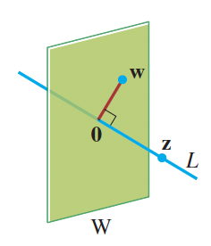
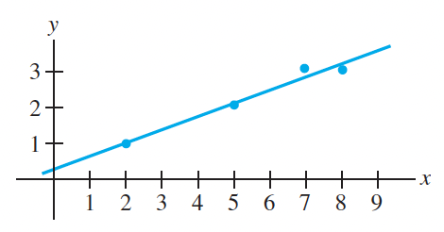
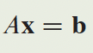
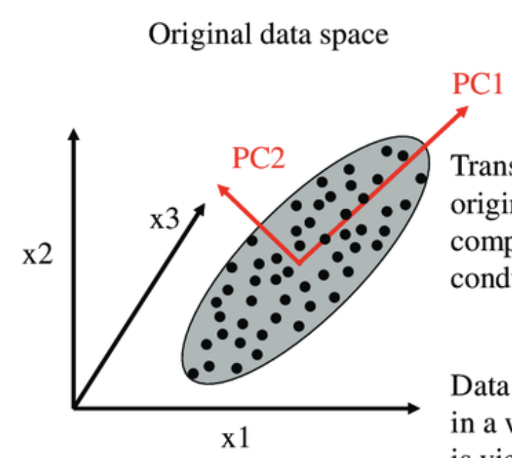
Syllabus for Part 2
Chapter | Topics | Week (Lecture) | Week (Tut)
6 | Orthogonality | 8-9 | 9-10
7 | Least Squares | 9-10 | 10-11
8 | EigenValue and Eigenvectors | 11-12 | 12-13
9 | Singular Value Decomposition (SVD) | 13
Table 1: schedule

Slide 4
Online Video learning Schedule
https://www.youtube.com/channel/UCBzG5jg3huxiPkCt-Serrjw
Week | Part | Topic | Notes
8 | 6.1.1-6.2.3 | Orthogonality, Normalization, Dot-Product, Inequalities, | Lecture 1: 6.1.1 - 6.1.3 Lecture 2: 6.1.4 - 6.2.3
9 | 6.2.4-6.3.2 | Orthogonal/Orthonormal Sets, Basis, Gram Schmidt and QR Decomposition | Lecture 3: 6.2.4 Lecture 4: 6.2.5 – 6.3.2
10 | 7.1.1-7.2.1 | Least Squares and Normal Eqn, Projection Matrix, Applications | Lecture 5: 7.1.1 – 7.1.3 Lecture 6: 7.1.4 – 7.2.1
11 | 8.1.1-8.1.2 | Eigenvectors, Eigen-values, Characteristics Eqn | Lecture 7: 8.1.1 Lecture 8: 8.1.2
12 | 8.1.3-8.1.5 | Diagonalisation, Power of A, Change of basis | Lecture 9: 8.1.3 Lecture 10: 8.1.4 – 8.1.5
13 | 9.1.1-9.2 | Introduction to SVD and PCA (Not examined in quiz/exam) | Lecture 11: 9.1.1 – 9.2 Lecture 12: Quiz 2

Slide 5
How will we conduct the course?
Before the lectures, watch the videos according to the schedule in Table 1
You can watch past years zoom video recordings at
https://www.youtube.com/@linearalgebra1884/playlists?view=50&sort=dd&shelf_id=2
During lecture hours –
We will summarize the lectures and highlight the key points
Q&A.

Slide 6
References

Slide 7
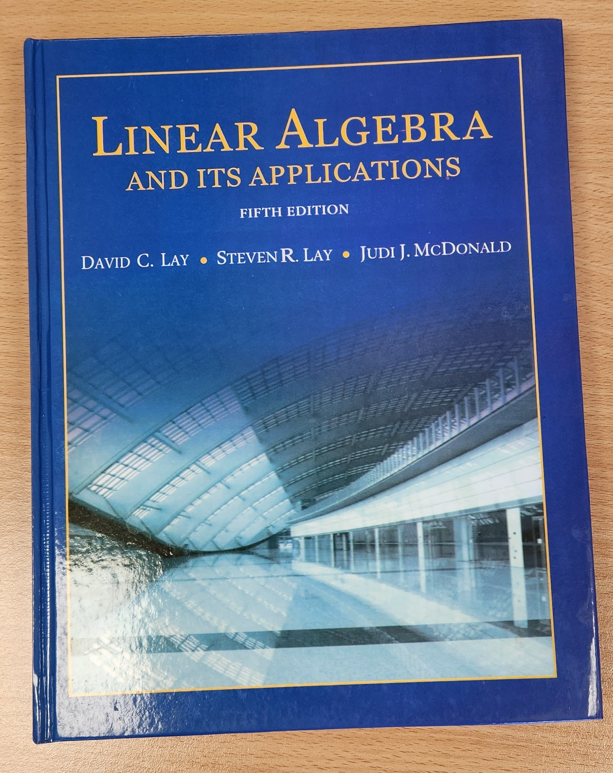

3Blue1Brown on YouTube
https://www.youtube.com/playlist?list=PLZHQObOWTQDPD3MizzM2xVFitgF8hE_ab
Linear Algebra and Its Applications
by David Lay, Steven Lay, Judi McDonald

Slide 8
Lecture (Week 11) (Chapter 8.1.1-8.1.2)

Slide 9
Key points – Overview of Chapter 8
Week 11
Eigenvalues and eigenvectors
Definition and explanations
Find eigenvectors given an eigenvalue
Eigenspace
Find eigenvalues
Week 12
Diagonalization
Motivation of diagonalization
Using eigenvalues and eigenvectors to diagonalize a matrix
Calculation of the power of a matrix
Coordinate system and change of basis
Understanding the concept of changing basis

Slide 10
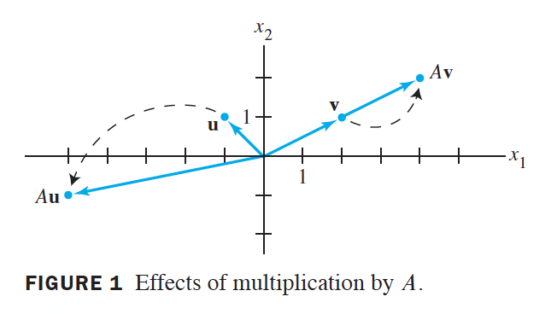
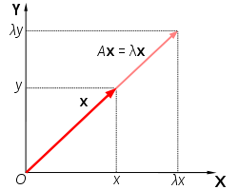
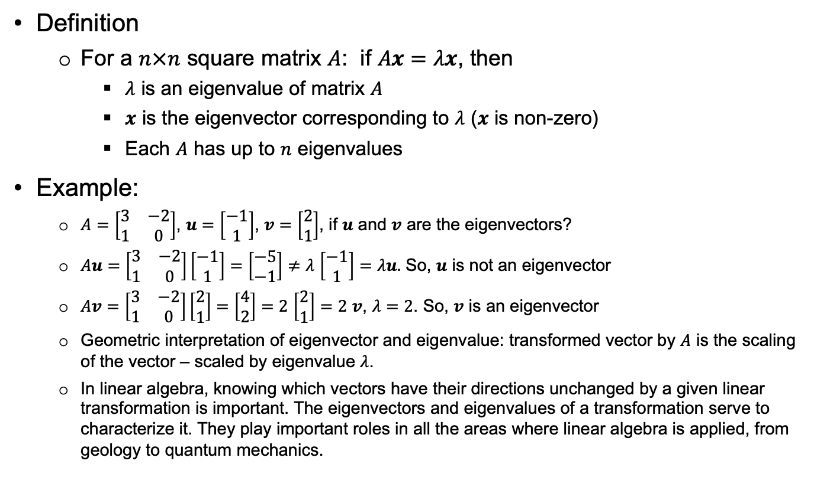

Key points – 8.1.1 Eigenvalue & Eigenvector
Definition
For a $n×n$ square matrix $A$: if $Ax=λx$, then
$λ$ is an eigenvalue of matrix $A$
$x$ is the eigenvector corresponding to $λ$ ($x$ is non-zero)
Each $A$ has up to $n$ eigenvalues
Example:
$A=\left[\begin{matrix}3 & −2 \\ 1 & 0\end{matrix}\right]$, $u=\left[\begin{matrix}−1 \\ 1\end{matrix}\right]$, $v=\left[\begin{matrix}2 \\ 1\end{matrix}\right]$, if $u$ and $v$ are the eigenvectors?
$Au=\left[\begin{matrix}3 & −2 \\ 1 & 0\end{matrix}\right]\left[\begin{matrix}−1 \\ 1\end{matrix}\right]=\left[\begin{matrix}−5 \\ −1\end{matrix}\right]≠λ$ $\left[\begin{matrix}−1 \\ 1\end{matrix}\right]=λu.$ So, $u$ is not an eigenvector
$Av=\left[\begin{matrix}3 & −2 \\ 1 & 0\end{matrix}\right]\left[\begin{matrix}2 \\ 1\end{matrix}\right]=$ $\left[\begin{matrix}4 \\ 2\end{matrix}\right]=2$ $\left[\begin{matrix}2 \\ 1\end{matrix}\right]=2$ $v$, $λ=2$. So, $v$ is an eigenvector
Geometric interpretation of eigenvector and eigenvalue: transformed vector by $A$ is the scaling of the vector – scaled by eigenvalue $λ$.
In linear algebra, knowing which vectors have their directions unchanged by a given linear transformation is important. The eigenvectors and eigenvalues of a transformation serve to characterize it. They play important roles in all the areas where linear algebra is applied, from geology to quantum mechanics.
Note: eigenvalue/eigenvector is one of the most important concept in linear algebra, with many applications. We will learn two applications later: diagonalize a matrix, Principal Component Analysis (PCA).
The word eigenvalue comes from the German Eigenwert which means "proper or characteristic value."

Slide 11
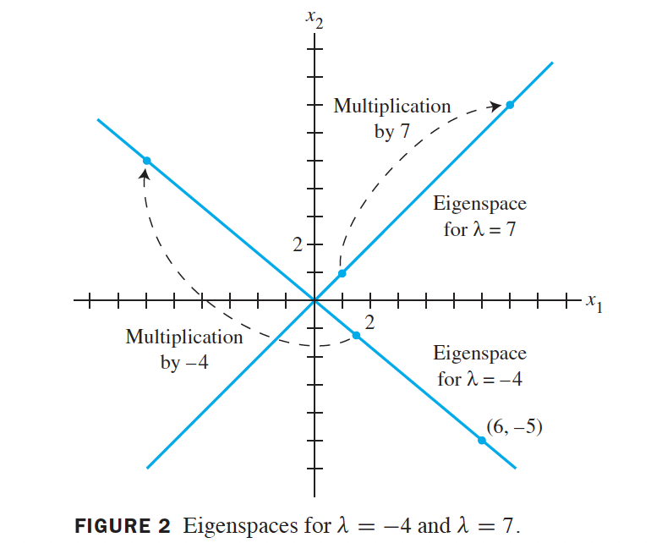
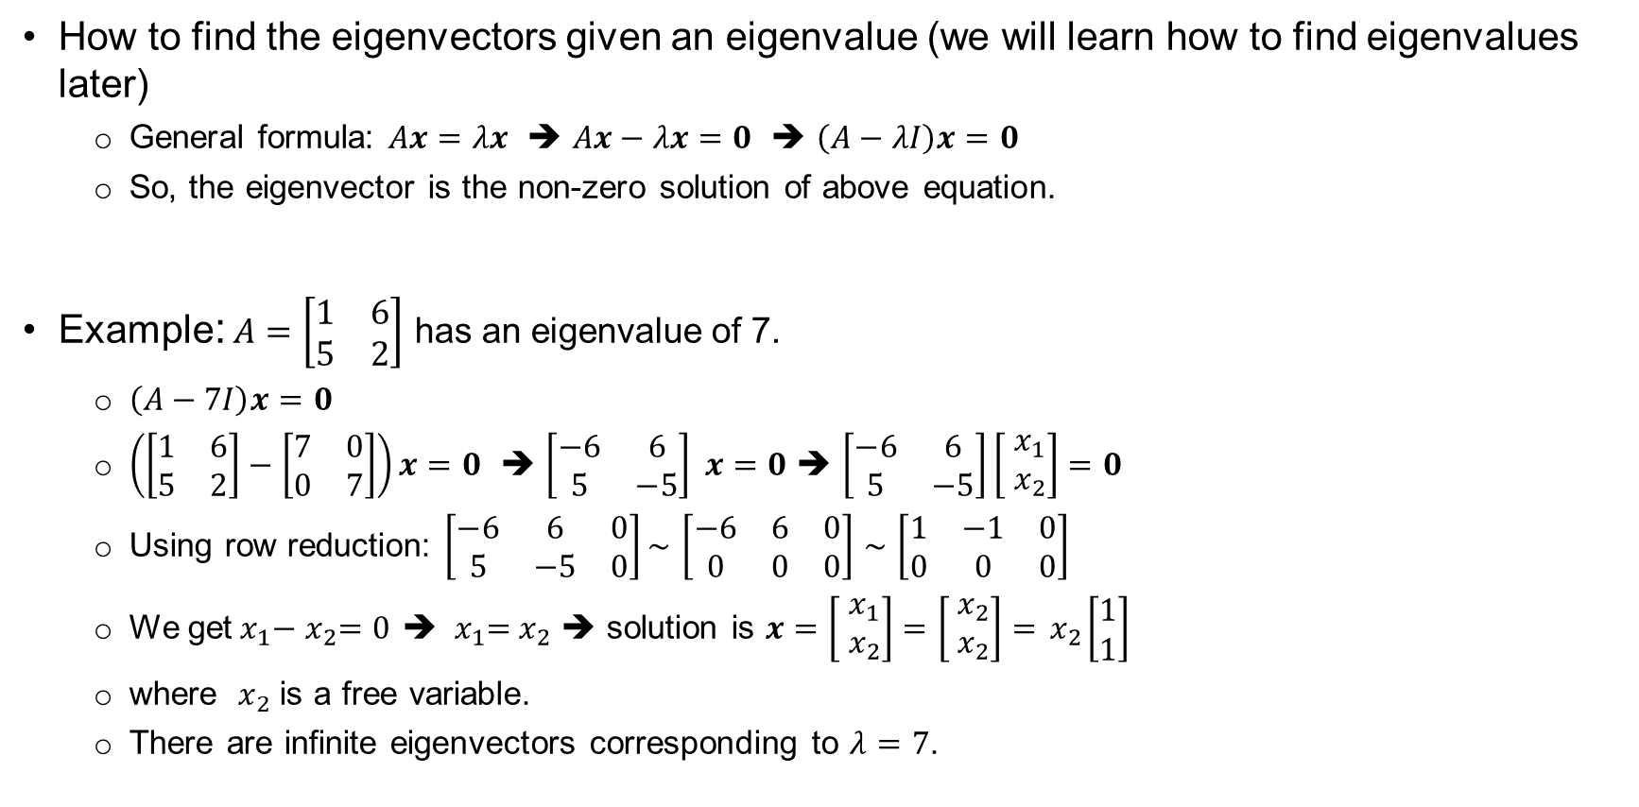
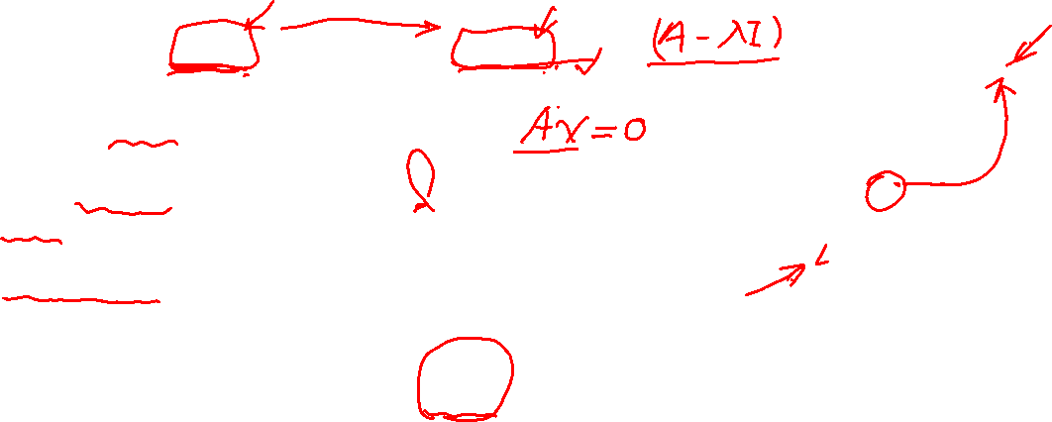
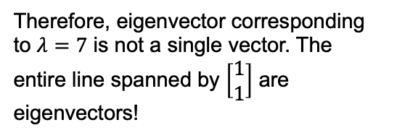
Key points – 8.1.1 Find Eigenvectors
How to find the eigenvectors given an eigenvalue (we will learn how to find eigenvalues later)
General formula: $Ax=λx$ ➔ $Ax−λx=0$ ➔ $\left(A−λI\right)x=0$
So, the eigenvector is the non-zero solution of above equation.
Example: $A=\left[\begin{matrix}1 & 6 \\ 5 & 2\end{matrix}\right]$ has an eigenvalue of 7.
$\left(A−7I\right)x=0$
$\left(\left[\begin{matrix}1 & 6 \\ 5 & 2\end{matrix}\right]−\left[\begin{matrix}7 & 0 \\ 0 & 7\end{matrix}\right]\right)x=0$ ➔ $\left[\begin{matrix}−6 & 6 \\ 5 & −5\end{matrix}\right] x=0$ ➔ $\left[\begin{matrix}−6 & 6 \\ 5 & −5\end{matrix}\right]\left[\begin{matrix}{ x}_{1} \\ { x}_{2}\end{matrix}\right]=0$
Using row reduction: $\left[\begin{matrix}−6 & 6 & 0 \\ 5 & −5 & 0\end{matrix}\right]\sim$ $\left[\begin{matrix}−6 & 6 & 0 \\ 0 & 0 & 0\end{matrix}\right]$ $\sim$ $\left[\begin{matrix}1 & −1 & 0 \\ 0 & 0 & 0\end{matrix}\right]$
We get${ x}_{1}−{ x}_{2}=0$ ➔ ${ x}_{1}={ x}_{2}$ ➔ solution is $x=\left[\begin{matrix}{ x}_{1} \\ { x}_{2}\end{matrix}\right]=$ $\left[\begin{matrix}{ x}_{2} \\ { x}_{2}\end{matrix}\right]={ x}_{2}\left[\begin{matrix}1 \\ 1\end{matrix}\right]$
where ${ x}_{2}$ is a free variable.
There are infinite eigenvectors corresponding to $λ=7$.
Therefore, eigenvector corresponding to $λ=7$ is not a single vector. The entire line spanned by $\left[\begin{matrix}1 \\ 1\end{matrix}\right]$ are eigenvectors!

Slide 12
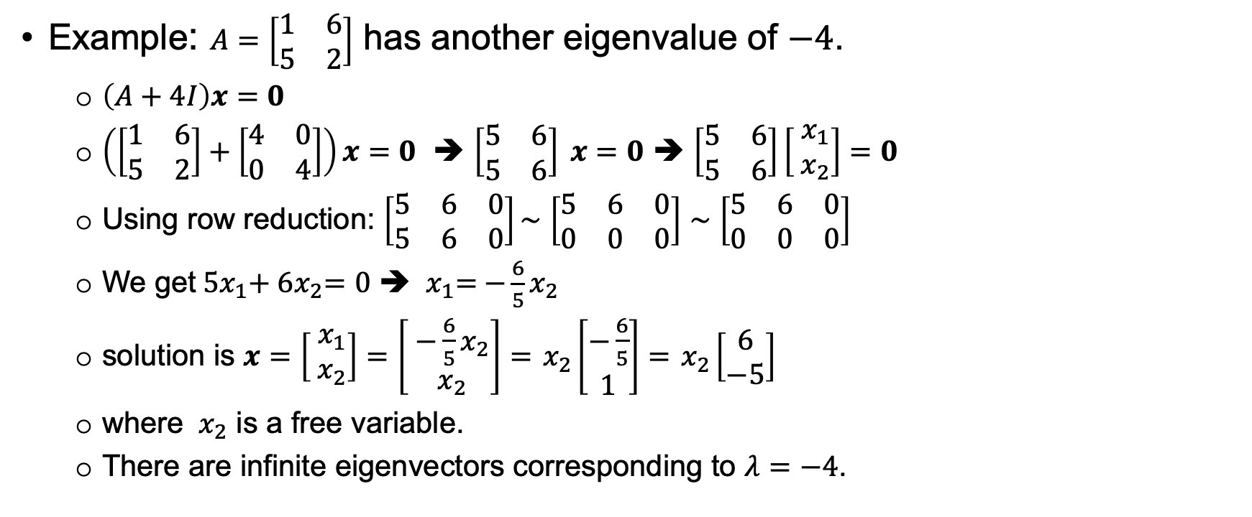

Key points – 8.1.1 Find Eigenvectors (2)
Example: $A=\left[\begin{matrix}1 & 6 \\ 5 & 2\end{matrix}\right]$ has another eigenvalue of $−4$.
$\left(A+4I\right)x=0$
$\left(\left[\begin{matrix}1 & 6 \\ 5 & 2\end{matrix}\right]+\left[\begin{matrix}4 & 0 \\ 0 & 4\end{matrix}\right]\right)x=0$ ➔ $\left[\begin{matrix}5 & 6 \\ 5 & 6\end{matrix}\right] x=0$ ➔ $\left[\begin{matrix}5 & 6 \\ 5 & 6\end{matrix}\right]\left[\begin{matrix}{ x}_{1} \\ { x}_{2}\end{matrix}\right]=0$
Using row reduction: $\left[\begin{matrix}5 & 6 & 0 \\ 5 & 6 & 0\end{matrix}\right]\sim$ $\left[\begin{matrix}5 & 6 & 0 \\ 0 & 0 & 0\end{matrix}\right]$ $\sim$ $\left[\begin{matrix}5 & 6 & 0 \\ 0 & 0 & 0\end{matrix}\right]$
We get${ 5x}_{1}+{ 6x}_{2}=0$ ➔ ${ x}_{1}={ −\frac{6}{5}x}_{2}$
solution is $x=\left[\begin{matrix}{ x}_{1} \\ { x}_{2}\end{matrix}\right]=$ $\left[\begin{matrix}{ −\frac{6}{5}x}_{2} \\ { x}_{2}\end{matrix}\right]={ x}_{2}\left[\begin{matrix}−\frac{6}{5} \\ 1\end{matrix}\right]={ x}_{2}\left[\begin{matrix}6 \\ −5\end{matrix}\right]$
where ${ x}_{2}$ is a free variable.
There are infinite eigenvectors corresponding to $λ=−4$.

Slide 13

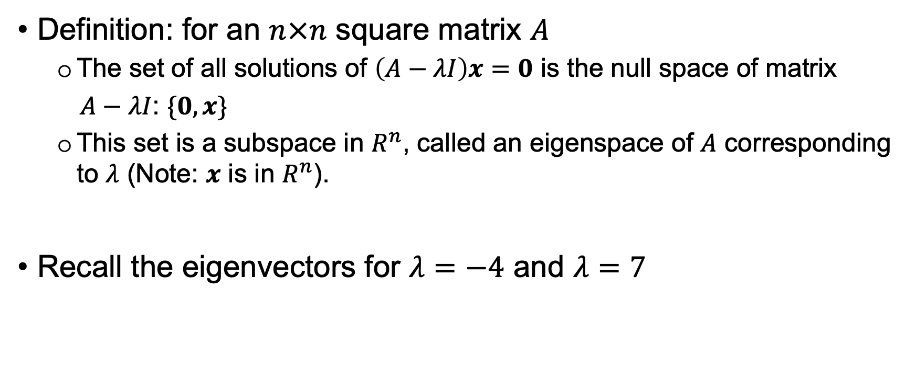

Key points – 8.1.1 Eigenspace
Definition: for an $n×n$ square matrix $A$
The set of all solutions of $\left(A−λI\right)x=0$ is the null space of matrix
$A−λI$: $\{0,x\}$
This set is a subspace in $R^{n}$, called an eigenspace of $A$ corresponding to $λ$ (Note: $x$ is in $R^{n}$).
Recall the eigenvectors for $λ=−4$ and $λ=7$

Slide 14
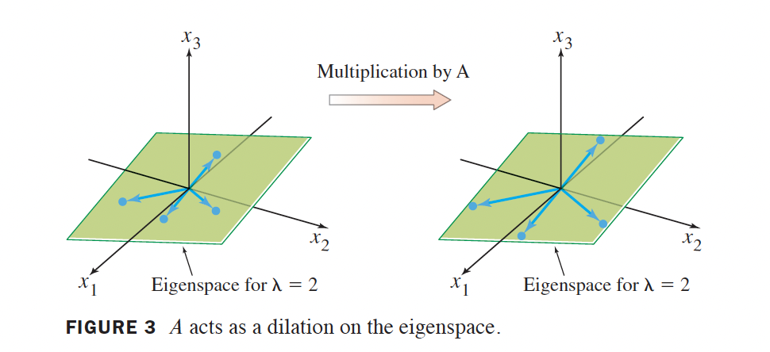

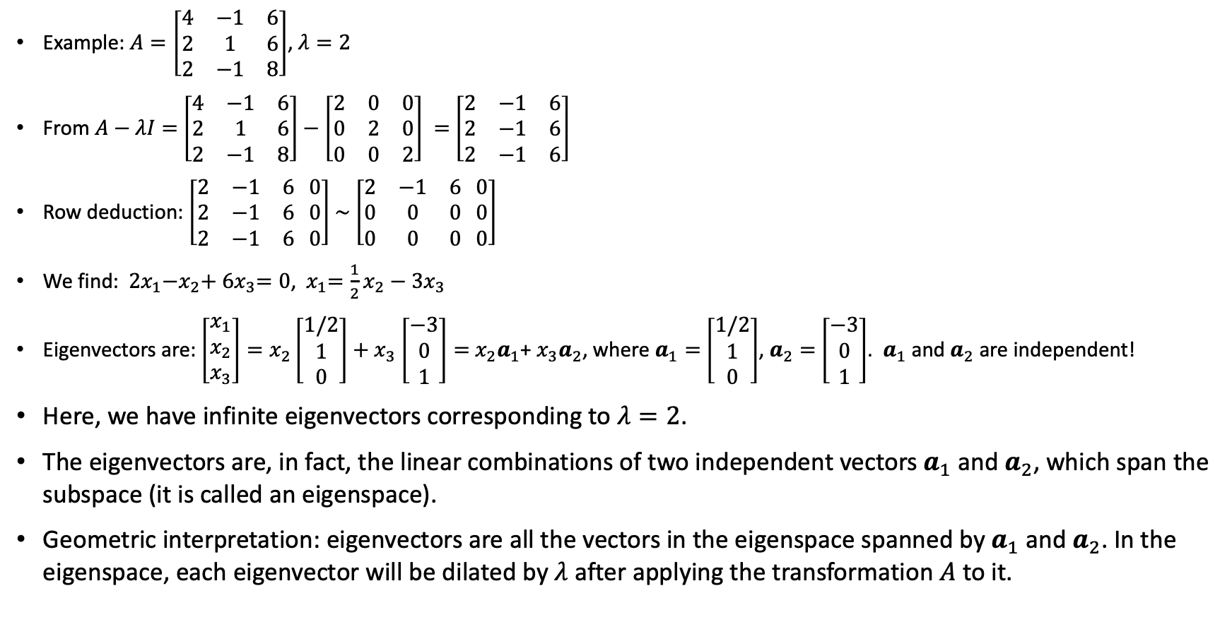
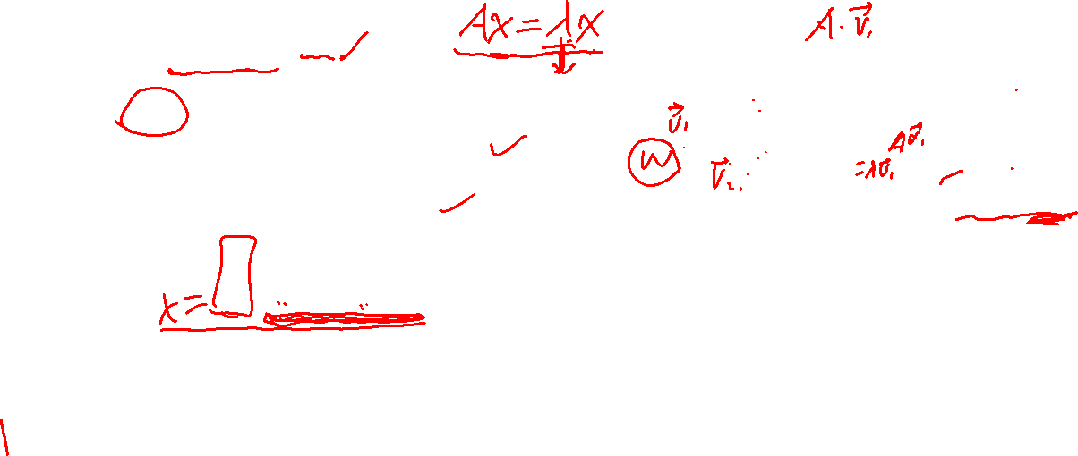
Key points – 8.1.1 Eigenspace (2).
Example: $A=\left[\begin{matrix}4 & −1 & 6 \\ 2 & 1 & 6 \\ 2 & −1 & 8\end{matrix}\right]$, $λ=2$
From $A−λI=$ $\left[\begin{matrix}4 & −1 & 6 \\ 2 & 1 & 6 \\ 2 & −1 & 8\end{matrix}\right]−\left[\begin{matrix}2 & 0 & 0 \\ 0 & 2 & 0 \\ 0 & 0 & 2\end{matrix}\right] =$ $\left[\begin{matrix}2 & −1 & 6 \\ 2 & −1 & 6 \\ 2 & −1 & 6\end{matrix}\right]$
Row deduction: $\left[\begin{matrix}2 & −1 & 6 \\ 2 & −1 & 6 \\ 2 & −1 & 6\end{matrix} \begin{matrix}0 \\ 0 \\ 0\end{matrix}\right]$ $\sim$ $\left[\begin{matrix}2 & −1 & 6 \\ 0 & 0 & 0 \\ 0 & 0 & 0\end{matrix} \begin{matrix}0 \\ 0 \\ 0\end{matrix}\right]$
We find: ${ 2x}_{1}−x_{2}+{ 6x}_{3}=0$, ${ x}_{1}=\frac{1}{2}x_{2}−{ 3x}_{3}$
Eigenvectors are: $\left[\begin{matrix}x_{1} \\ x_{2} \\ x_{3}\end{matrix}\right]=x_{2}\left[\begin{matrix}1/2 \\ 1 \\ 0\end{matrix}\right]+x_{3}$ $\left[\begin{matrix}−3 \\ 0 \\ 1\end{matrix}\right]=$ $x_{2}a_{1}$+ $x_{3}a_{2}$, where $a_{1}=$ $\left[\begin{matrix}1/2 \\ 1 \\ 0\end{matrix}\right]$, $a_{2}=$ $\left[\begin{matrix}−3 \\ 0 \\ 1\end{matrix}\right]$. $a_{1}$ and $a_{2}$ are independent!
Here, we have infinite eigenvectors corresponding to $λ=2$.
The eigenvectors are, in fact, the linear combinations of two independent vectors $a_{1}$ and $a_{2}$, which span the subspace (it is called an eigenspace).
Geometric interpretation: eigenvectors are all the vectors in the eigenspace spanned by $a_{1}$ and $a_{2}$. In the eigenspace, each eigenvector will be dilated by $λ$ after applying the transformation $A$ to it.

Slide 15
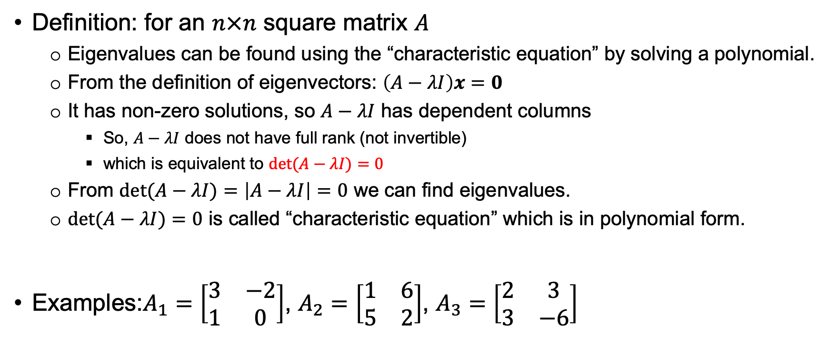

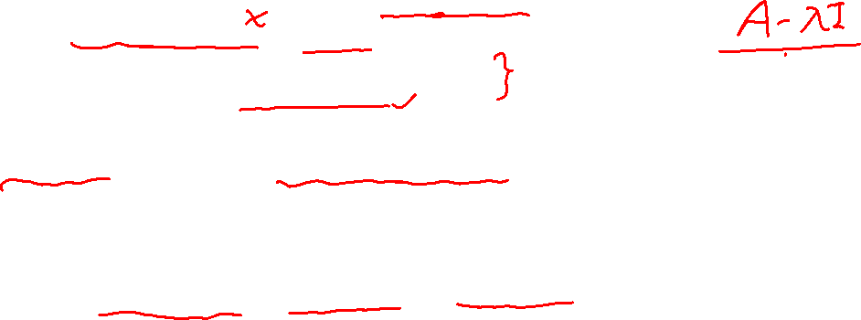
Key points – 8.1.2 Find Eigenvalues
Definition: for an $n×n$ square matrix $A$
Eigenvalues can be found using the “characteristic equation” by solving a polynomial.
From the definition of eigenvectors: $\left(A−λI\right)x=0$
It has non-zero solutions, so $A−λI$ has dependent columns
So, $A−λI$ does not have full rank (not invertible)
which is equivalent to $det(A−λI)=0$
From $det(A−λI)=\left|A−λI\right|=0$ we can find eigenvalues.
$det(A−λI)=0$ is called “characteristic equation” which is in polynomial form.
Examples:$A_{1}=\left[\begin{matrix}3 & −2 \\ 1 & 0\end{matrix}\right]$, $A_{2}=\left[\begin{matrix}1 & 6 \\ 5 & 2\end{matrix}\right]$, $A_{3}=\left[\begin{matrix}2 & 3 \\ 3 & −6\end{matrix}\right]$

Slide 16
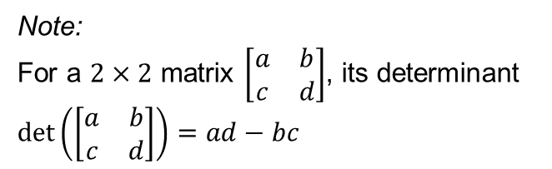
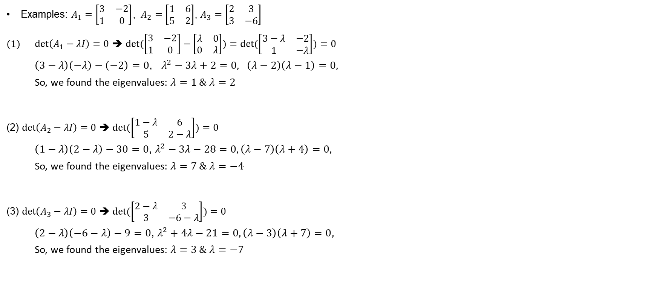
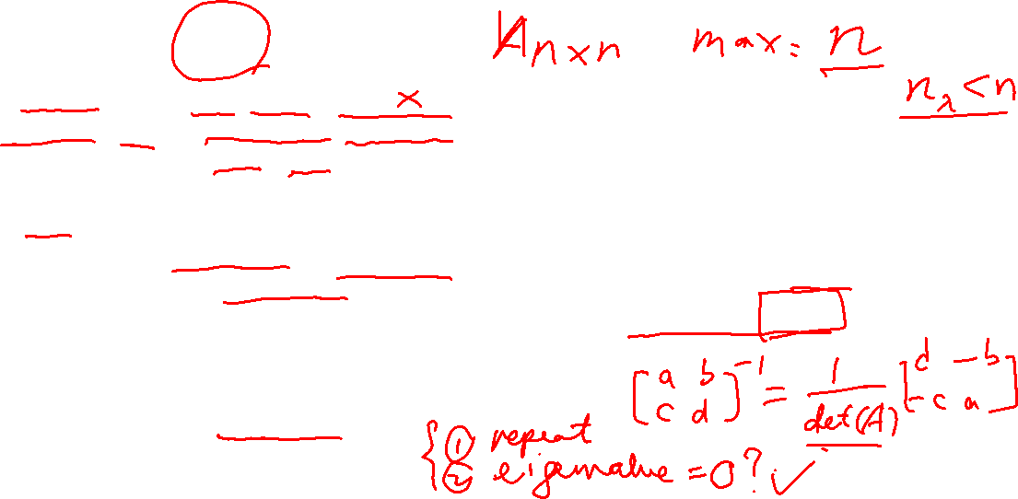
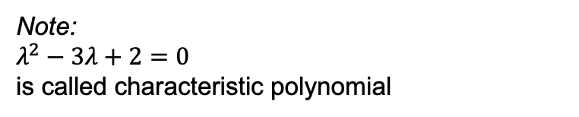
Key points – 8.1.2 Find Eigenvalues: examples
Examples: $A_{1}=\left[\begin{matrix}3 & −2 \\ 1 & 0\end{matrix}\right]$, $A_{2}=\left[\begin{matrix}1 & 6 \\ 5 & 2\end{matrix}\right]$, $A_{3}=\left[\begin{matrix}2 & 3 \\ 3 & −6\end{matrix}\right]$
$det\left(A_{1}−λI\right)=0$ ➔ $det(\left[\begin{matrix}3 & −2 \\ 1 & 0\end{matrix}\right]−\left[\begin{matrix}λ & 0 \\ 0 & λ\end{matrix}\right])=det(\left[\begin{matrix}3−λ & −2 \\ 1 & −λ\end{matrix}\right])=0$
$\left(3−λ\right)\left(−λ\right)−\left(−2\right)=0$, $λ^{2}−3λ+2=0, \left(λ−2\right)\left(λ−1\right)=0,$
So, we found the eigenvalues: $λ=1 \& λ=2$
(2) $det\left(A_{2}−λI\right)=0$ ➔$det(\left[\begin{matrix}1−λ & 6 \\ 5 & 2−λ\end{matrix}\right])=0$
$\left(1−λ\right)\left(2−λ\right)−30=0$, $λ^{2}−3λ−28=0, \left(λ−7\right)\left(λ+4\right)=0,$
So, we found the eigenvalues: $λ=7 \& λ=−4$
(3) $det\left(A_{3}−λI\right)=0$ ➔$det(\left[\begin{matrix}2−λ & 3 \\ 3 & −6−λ\end{matrix}\right])=0$
$\left(2−λ\right)\left(−6−λ\right)−9=0$, $λ^{2}+4λ−21=0, \left(λ−3\right)\left(λ+7\right)=0,$
So, we found the eigenvalues: $λ=3 \& λ=−7$
Note:
$λ^{2}−3λ+2=0$
is called characteristic polynomial
Note:
For a $2×2$ matrix $\left[\begin{matrix}a & b \\ c & d\end{matrix}\right]$, its determinant $det\left(\left[\begin{matrix}a & b \\ c & d\end{matrix}\right]\right)=ad−bc$

Slide 17
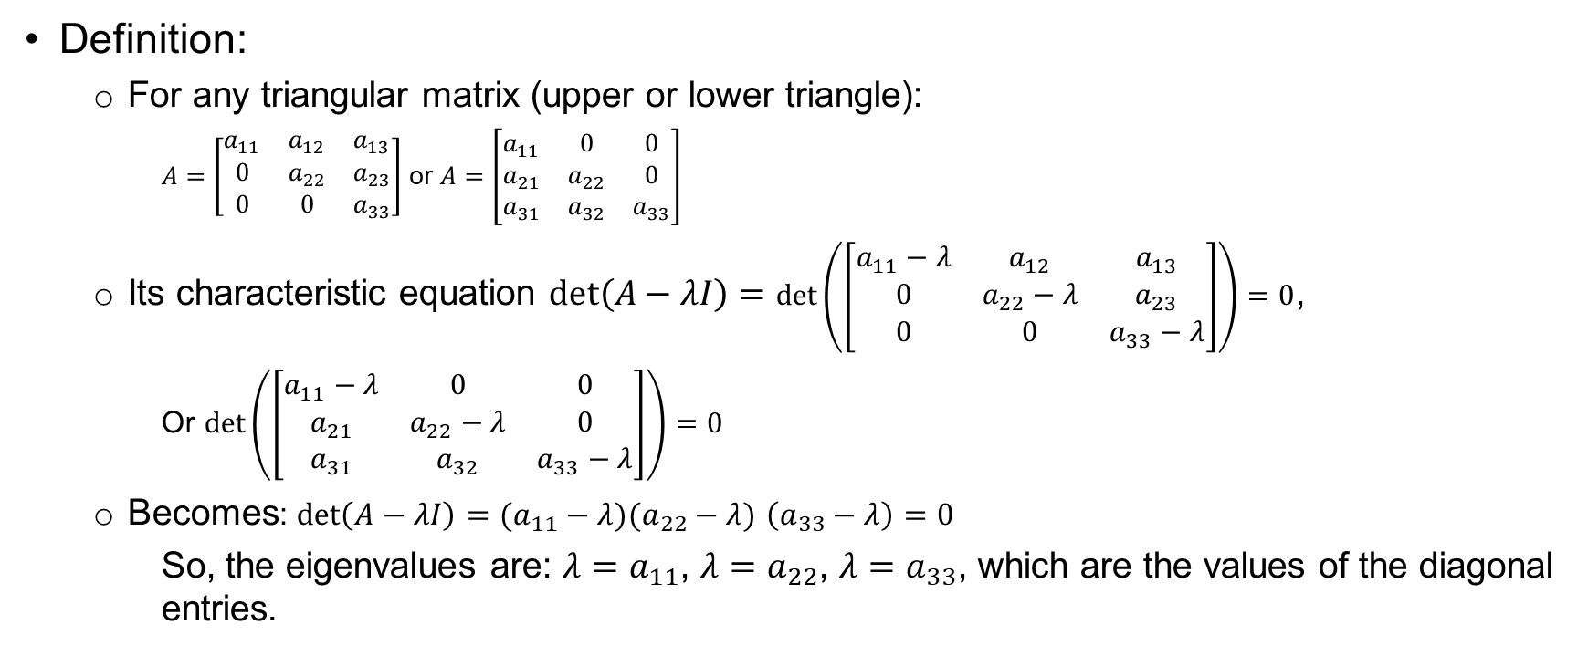


Key points – 8.1.2 Find Eigenvalues: Triangular Matrix
Definition:
For any triangular matrix (upper or lower triangle):
$A=\left[\begin{matrix}a_{11} & a_{12} & a_{13} \\ 0 & a_{22} & a_{23} \\ 0 & 0 & a_{33}\end{matrix}\right]$ or $A=\left[\begin{matrix}a_{11} & 0 & 0 \\ a_{21} & a_{22} & 0 \\ a_{31} & a_{32} & a_{33}\end{matrix}\right]$
Its characteristic equation $det\left(A−λI\right)=$ $det\left(\left[\begin{matrix}a_{11}−λ & a_{12} & a_{13} \\ 0 & a_{22}−λ & a_{23} \\ 0 & 0 & a_{33}−λ\end{matrix}\right]\right)=0$,
Or $det\left(\left[\begin{matrix}a_{11}−λ & 0 & 0 \\ a_{21} & a_{22}−λ & 0 \\ a_{31} & a_{32} & a_{33}−λ\end{matrix}\right]\right)=0$
Becomes: $det\left(A−λI\right)=(a_{11}−λ)(a_{22}−λ)$ $\left(a_{33}−λ\right)=0$
So, the eigenvalues are: ${λ=a}_{11}$, ${λ=a}_{22}$, ${λ=a}_{33}$, which are the values of the diagonal entries.

Slide 18
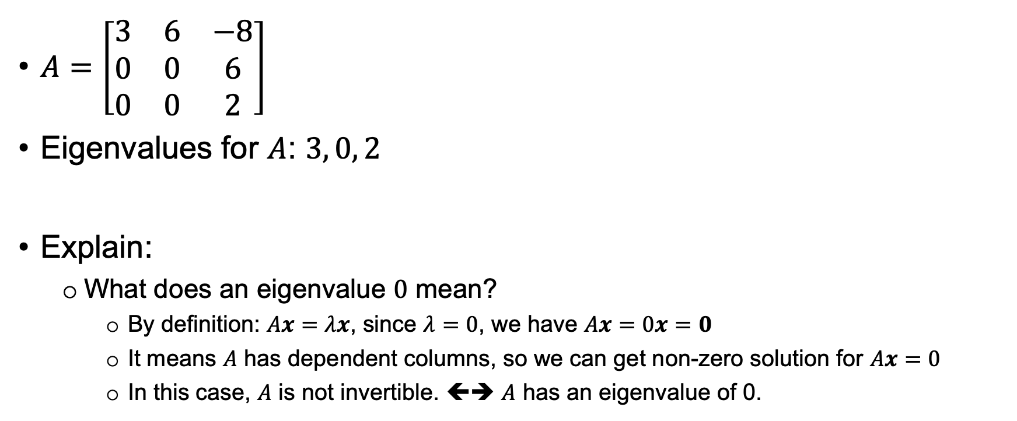
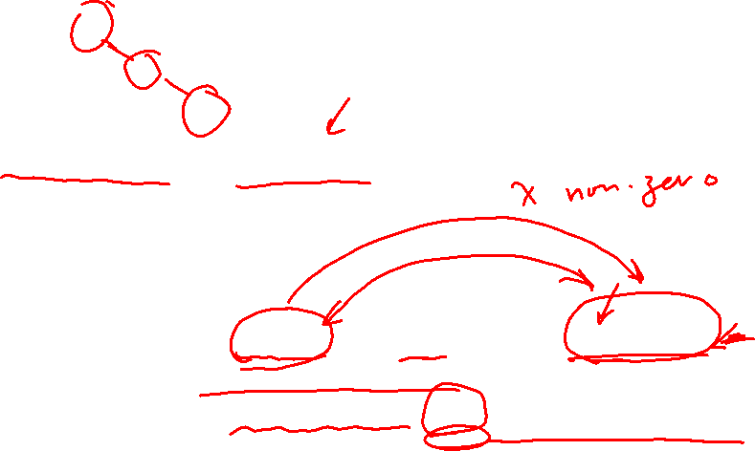
Key points – 8.1.2 Eigenvalues: More Examples
$A=\left[\begin{matrix}3 & 6 & −8 \\ 0 & 0 & 6 \\ 0 & 0 & 2\end{matrix}\right]$
Eigenvalues for $A$: $3, 0, 2$
Explain:
What does an eigenvalue $0$ mean?
By definition: $Ax=λx$, since $λ=0$, we have $Ax=0x=0$
It means $A$ has dependent columns, so we can get non-zero solution for $Ax=0$
In this case, $A$ is not invertible. ⬅➔ $A$ has an eigenvalue of 0.

Slide 19
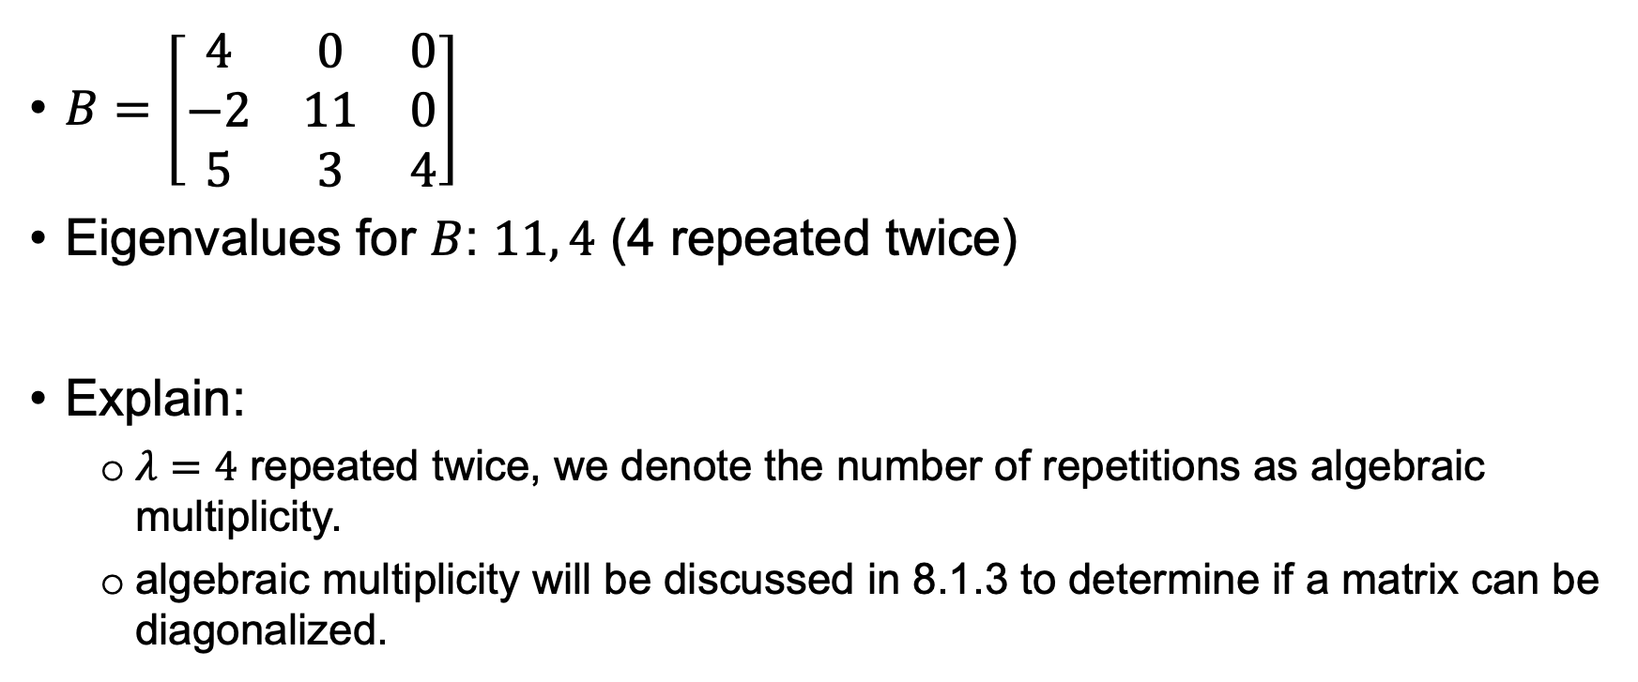
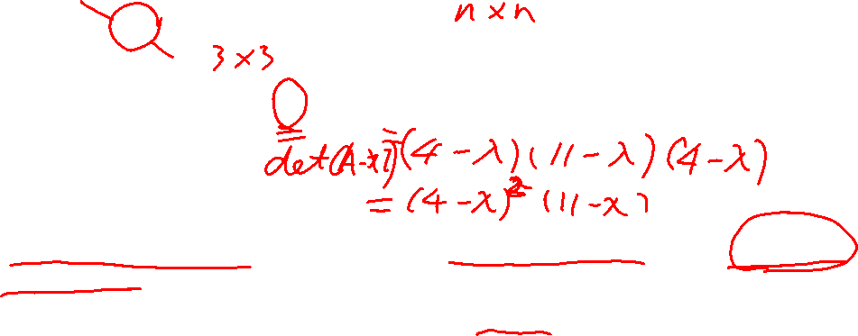
Key points – 8.1.2 Eigenvalues: More Examples (2)
$B=\left[\begin{matrix}4 & 0 & 0 \\ −2 & 11 & 0 \\ 5 & 3 & 4\end{matrix}\right]$
Eigenvalues for $B$: $11, 4$ (4 repeated twice)
Explain:
$λ=4$ repeated twice, we denote the number of repetitions as algebraic multiplicity.
algebraic multiplicity will be discussed in 8.1.3 to determine if a matrix can be diagonalized.

Slide 20
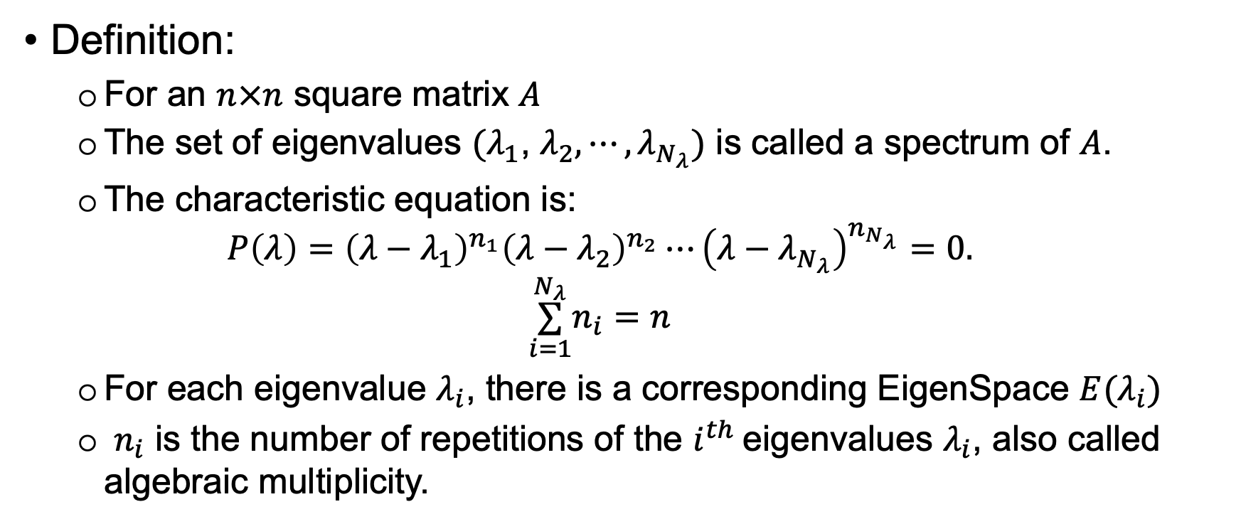
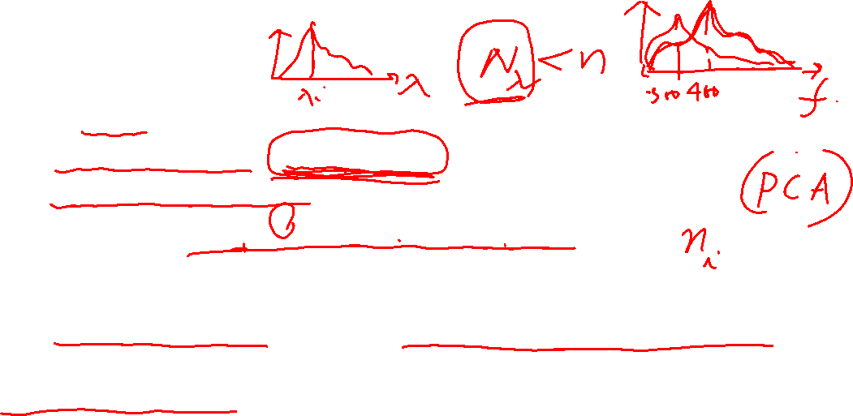
Key points – 8.1.2 Spectrum of a matrix
Definition:
For an $n×n$ square matrix $A$
The set of eigenvalues ${(λ}_{1}$, $λ_{2},⋯,λ_{N_{λ}})$ is called a spectrum of $A$.
The characteristic equation is:
$$P\left(λ\right)={\left(λ−λ_{1}\right)}^{n_{1}}{\left(λ−λ_{2}\right)}^{n_{2}}⋯{\left(λ−λ_{N_{λ}}\right)}^{n_{N_{λ}}}=0.$$
$$\overset{N_{λ}}{\underset{i=1}{∑}}n_{i}=n$$
For each eigenvalue $λ_{i}$, there is a corresponding EigenSpace $E(λ_{i})$
$n_{i}$ is the number of repetitions of the $i^{th}$eigenvalues $λ_{i}$, also called algebraic multiplicity.

Slide 21
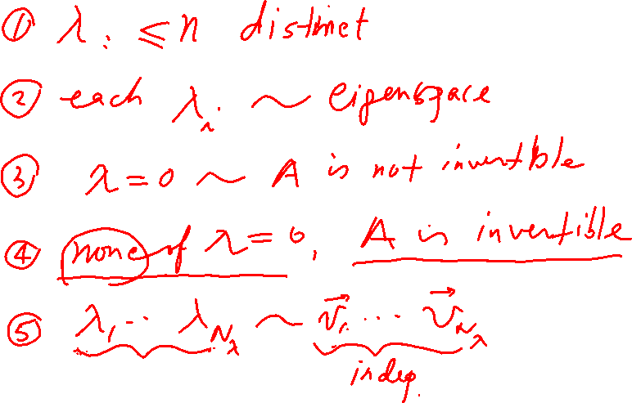

Slide 22
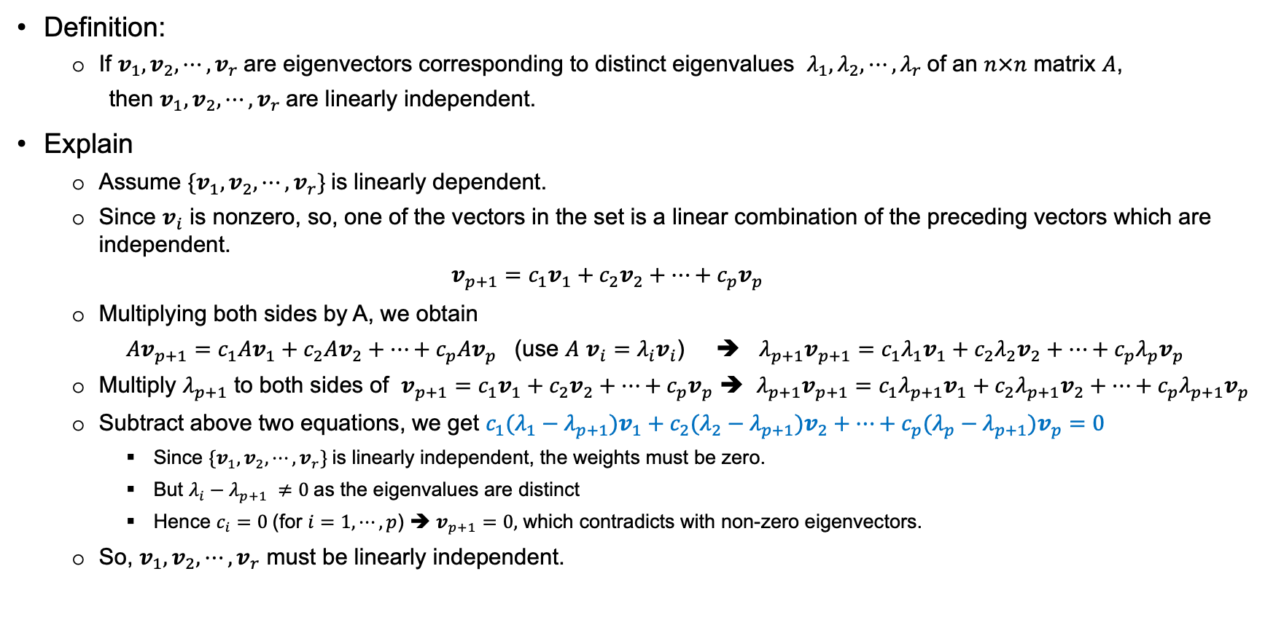
Key points – Independence of Eigenvectors Corresponding to Eigenvalues
Definition:
If $v_{1},v_{2},⋯,v_{r}$are eigenvectors corresponding to distinct eigenvalues $λ_{1},λ_{2},⋯,λ_{r}$of an $n×n$ matrix $A$,
then $v_{1},v_{2},⋯,v_{r}$are linearly independent.
Explain
Assume ${\{v}_{1},v_{2},⋯,v_{r}\}$is linearly dependent.
Since $v_{i}$ is nonzero, so, one of the vectors in the set is a linear combination of the preceding vectors which are independent.
$$v_{p+1}=c_{1}v_{1}+c_{2}v_{2}+⋯+c_{p}v_{p}$$
Multiplying both sides by A, we obtain
$Av_{p+1}=c_{1}Av_{1}+c_{2}Av_{2}+⋯+c_{p}Av_{p}$ (use $A$ $v_{i}=λ_{i}v_{i}$) ➔ $λ_{p+1}v_{p+1}=c_{1}λ_{1}v_{1}+c_{2}λ_{2}v_{2}+⋯+c_{p}λ_{p}v_{p}$
Multiply $λ_{p+1}$ to both sides of $v_{p+1}=c_{1}v_{1}+c_{2}v_{2}+⋯+c_{p}v_{p}$ ➔ $λ_{p+1}v_{p+1}=c_{1}λ_{p+1}v_{1}+c_{2}λ_{p+1}v_{2}+⋯+c_{p}λ_{p+1}v_{p}$
Subtract above two equations, we get $c_{1}(λ_{1}−λ_{p+1})v_{1}+c_{2}(λ_{2}−λ_{p+1})v_{2}+⋯+c_{p}(λ_{p}−λ_{p+1}{)v}_{p}=0$
Since ${\{v}_{1},v_{2},⋯,v_{r}\}$is linearly independent, the weights must be zero.
But $λ_{i}−λ_{p+1} ≠0$as the eigenvalues are distinct
Hence $c_{i}=0$(for $i=1,⋯,p$) ➔ $v_{p+1}=0,$ which contradicts with non-zero eigenvectors.
So, $v_{1},v_{2},⋯,v_{r}$ must be linearly independent.

Slide 23
End

